Slide 1
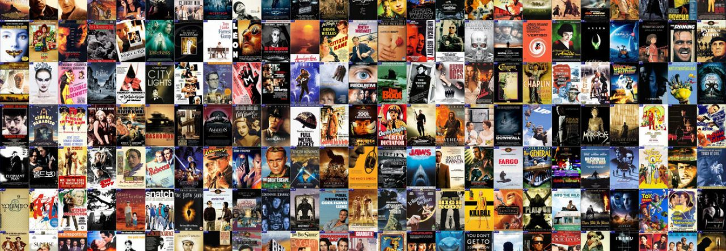
IMDB MOVIE ANALYSIS
PRESENTED BY - PRINCE

Slide 2
Project Description
EXCEL SHEET
VIDEO PRESENTATION
In this project, we will use IMDB dataset to find out what factors influence the success of a movie based on it’s ratings or IMDB score. Here, success can be defined by high IMDB ratings. The impact of this problem is significant for movie producers, directors, and investors who want to understand what makes a movie successful to make informed decisions in their future projects.

Slide 3
approach
The data collected from IMDB is loaded in MS EXCEL, we first converted the provided data into table format as it is easier for data analysis. We then cleaned the dataset including removing irrelevant columns and shortened the columns from 28 to 16 , removed duplicates present in the data. Then, we created new column ‘profit’ using ‘budget’ and ‘gross’ columns and ‘decade’ using LEFT function from ‘title_year’ column.
We see, there were missing values in columns director_names,actor3_name,actor2_name,actor1_name,movie_title,country and language which were imputed with ‘unknown’ and in gross and budget column with their mean values.
In genre column, there are multiple genres in the same cell for a movie, so , we used, Text to Columns feature of EXCEL to format table such that each row has a separate genre for a movie. At last, we corrected the names present in director_name and movie_name.
Further, we used various functions, pivot tables, charts, graphs, etc present in MS EXCEL to do the analysis and answer the questions asked.

Slide 4

Tech-stack used
We have used Microsoft® Excel® 2021 MSO (Version 2310 Build 16.0.16924.20054) 64-bit for our data analysis as Excel is jam-packed with features and functions that can be used to clean, aggregate, pivot, and graph data. Also, Excel has a user-friendly visual interface that allows individuals at any level of expertise to easily learn and utilize its capabilities.

Slide 5
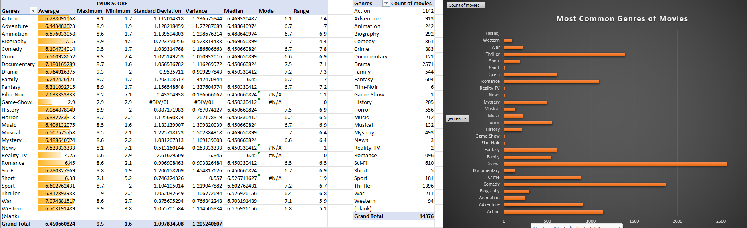
insights
MOVIE GENRE ANALYSIS :
Here, we observe that the most common genre of movies in the dataset is Drama followed by Comedy, Thriller, Action and Romance. Also, we see the impact of different genres on movies in Descriptive Statistics.

Slide 6
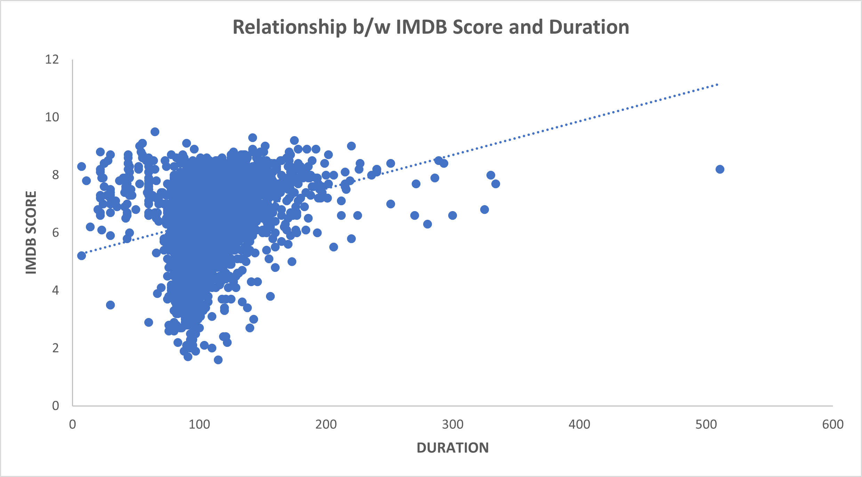

Movie duration analysis :
Here, on interpreting the trendline, we see that the Duration of movie has a positive relationship with IMDB score especially within the range of 60 to 200.
So, the director or team can keep this is mind while making the movie to ensure its success.
Also, we see the mean of duration is 107.21

Slide 7
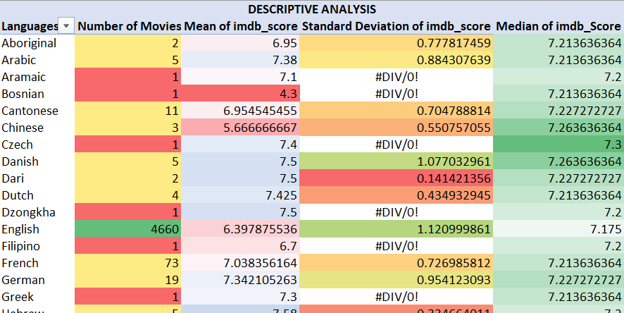
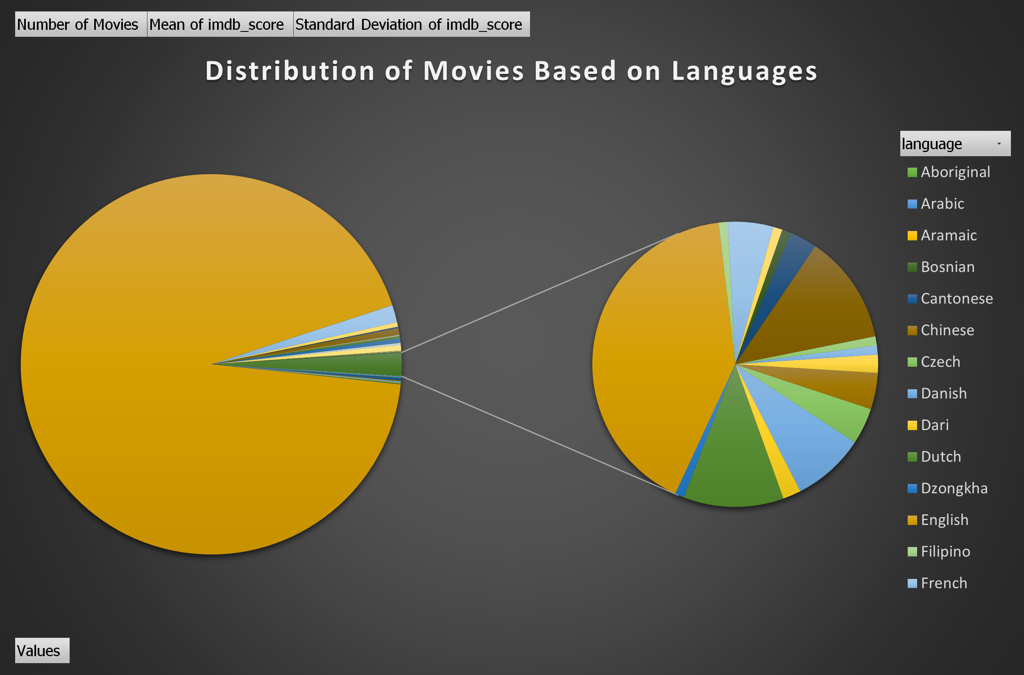
Language analysis:
Here, we observe that English language has the highest no of movies .
Also, we can check that language does not have a impact on IMDB score.

Slide 8
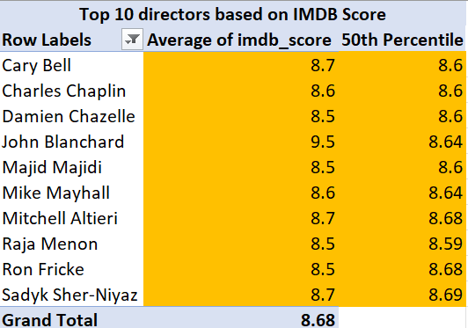
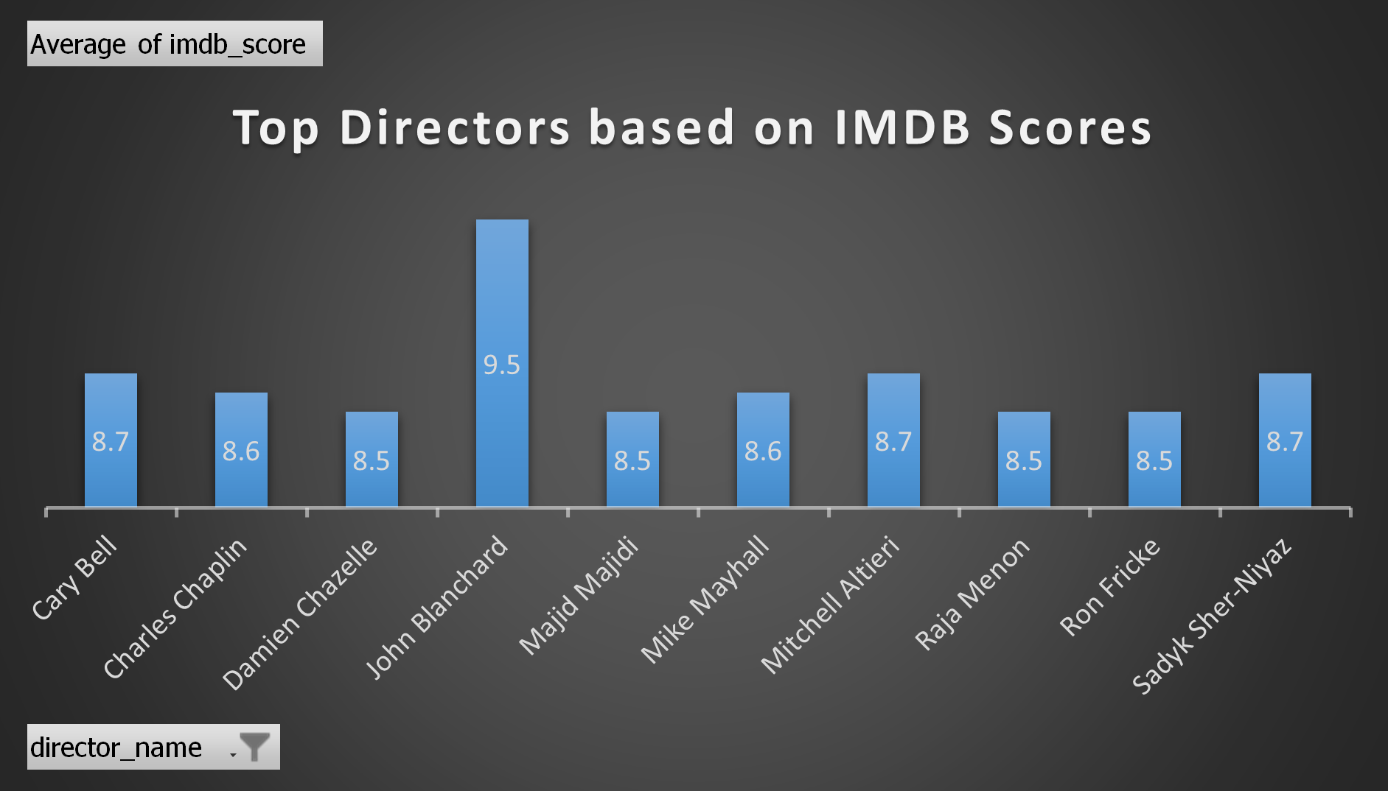
Director analysis:
In this, we observe that the director John Blanchard has the highest IMDB score of 9.5, followed by Cary Bell, Mitchell Altieri and Sadyk Sher-Niyaz with IMDB score of 8.7
Also, we can check the contribution of directors in the success of movies based upon the percentile column.

Slide 9
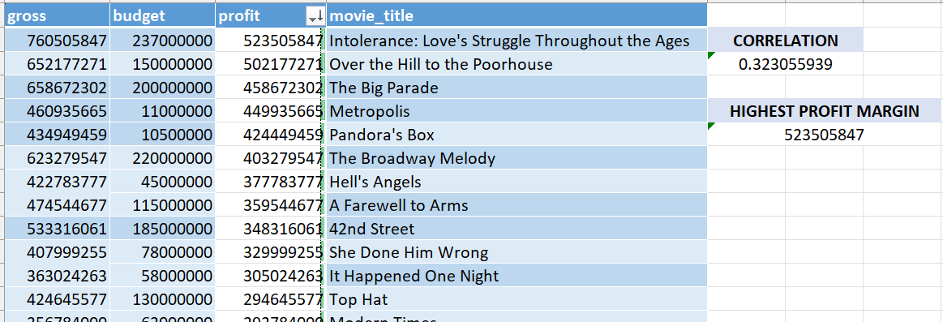
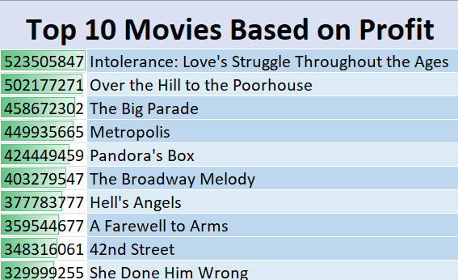
Budget analysis:
Here, we calculated the correlation coefficient between gross and budget columns using CORREL function of Excel. We see, they have a positive correlation of 0.323
Also, profit is calculated using gross-budget and then sorted the data based on profit column.
Using Excel’s MAX function, we calculated the highest profit margin . The movie Intolerance has the highest profit of 523505847.

Slide 10
results
The most common genre of movies in the dataset is Drama followed by Comedy, Thriller, Action and Romance, so the stakeholders can make more movies in these genres for more profit.
The Duration of movies has a positive relationship with IMDB score especially within the range of 60 to 200. So, the directors can make sure to have the movie duration within this range.
Language does not have a impact on the movie’s success. Also, the most common language used in movies is English, more movies could be made in English or dubbed in English language, provide subtitles to reach a larger audience.
The director John Blanchard has the highest IMDB score of 9.5, followed by Cary Bell, Mitchell Altieri and Sadyk Sher-Niyaz with IMDB score of 8.7. Stakeholders can hire these directors to make sure they profit from the movie.
Gross and Budget have a positive correlation of 0.323 . Movie with the highest profit is Intolerance, followed by Over the Hill to the Poorhouse, The Big Parade, Metropolis, Pandora’s Box, etc.

Slide 11


